Slide 1
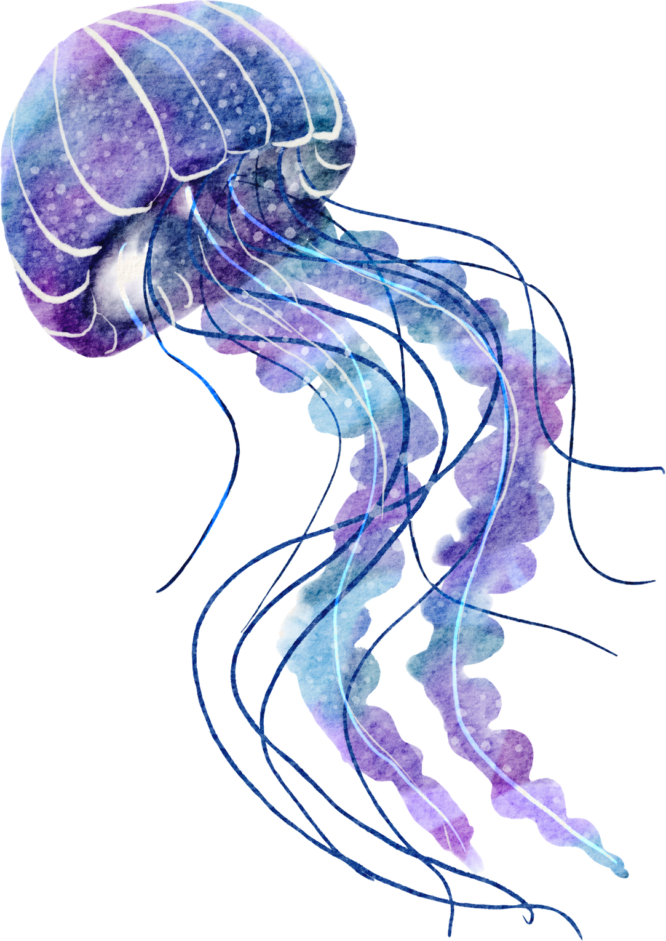
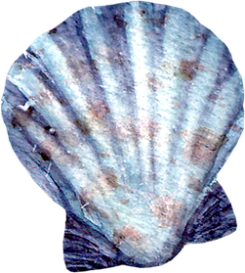

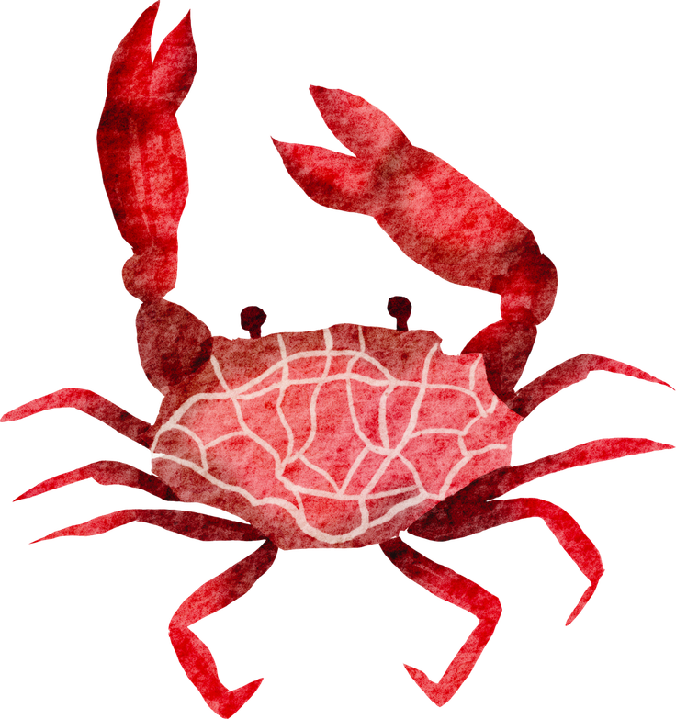
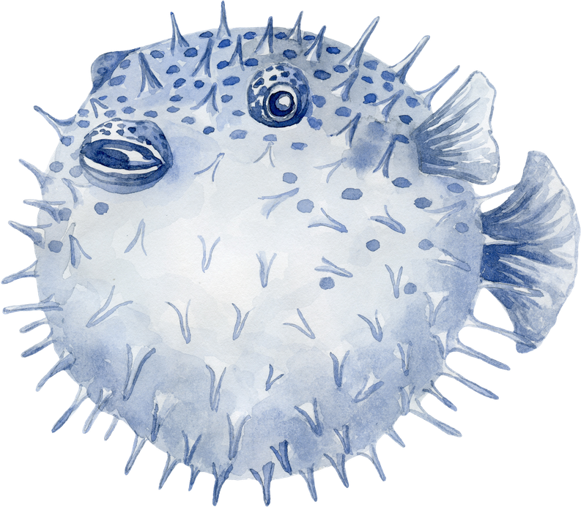



The Worshipful Company of Glass Sellers’ Doodle Competition 2026
Open to all primary & secondary age children across the UK
The winning schools receive a cash prize!
1st prize ~ £250
2nd prize ~ £150
3rd prize ~ £100
All prize winners will have their design sculpted in hot glass by Allister Malcolm and his amazing glass making team at Stourbridge Glass Museum!

Slide 2
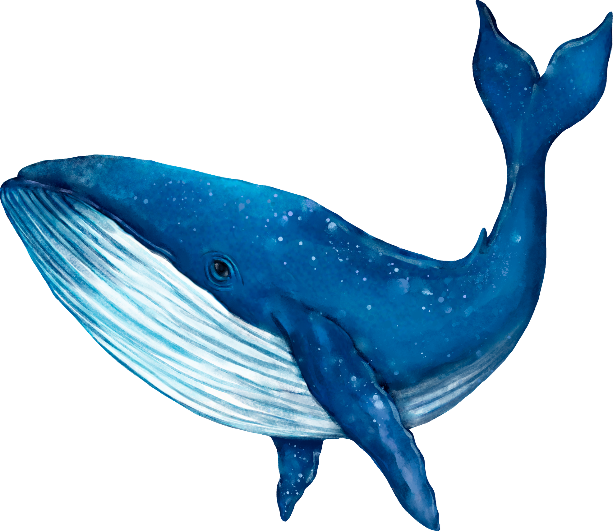
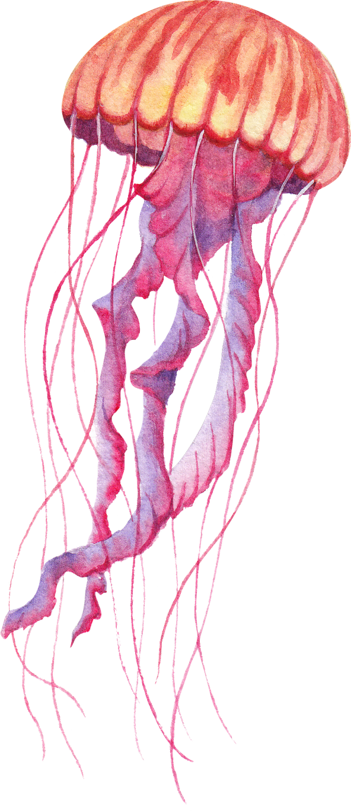
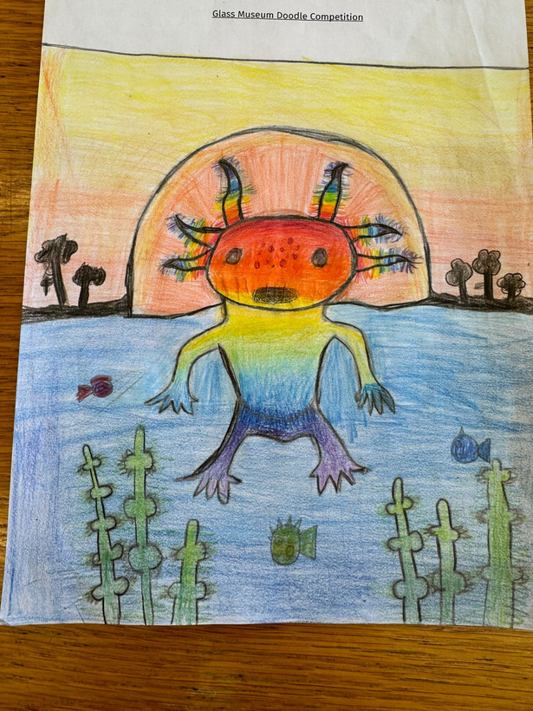
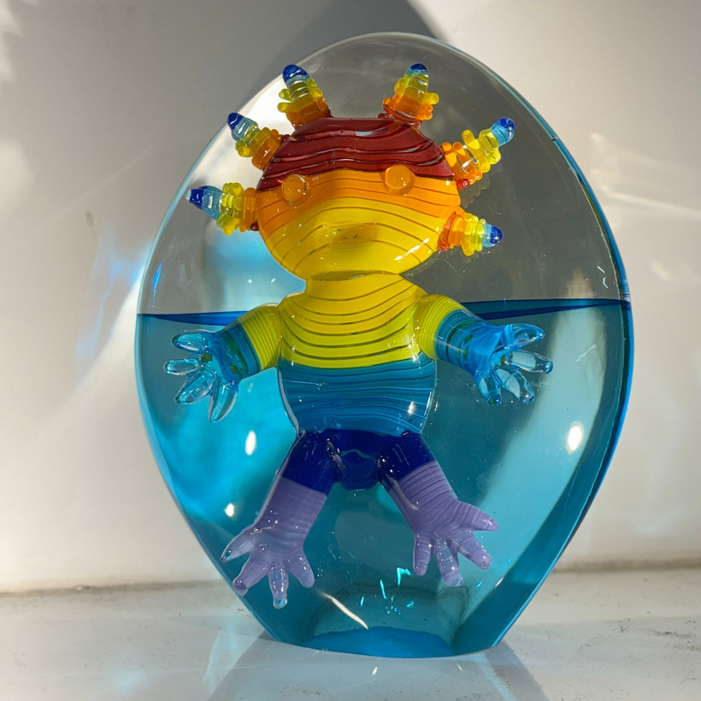
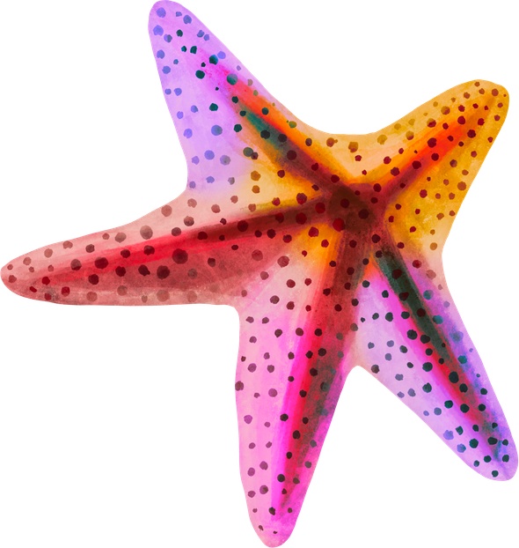

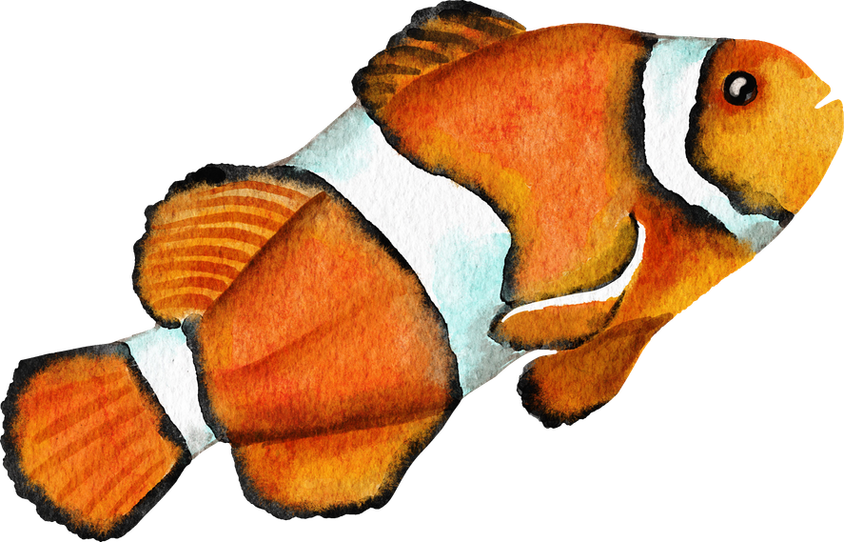
Your Drawing → A Glass Sculpture
Your idea could be turned into a real glass artwork.
→
Previous winning entry

Slide 3
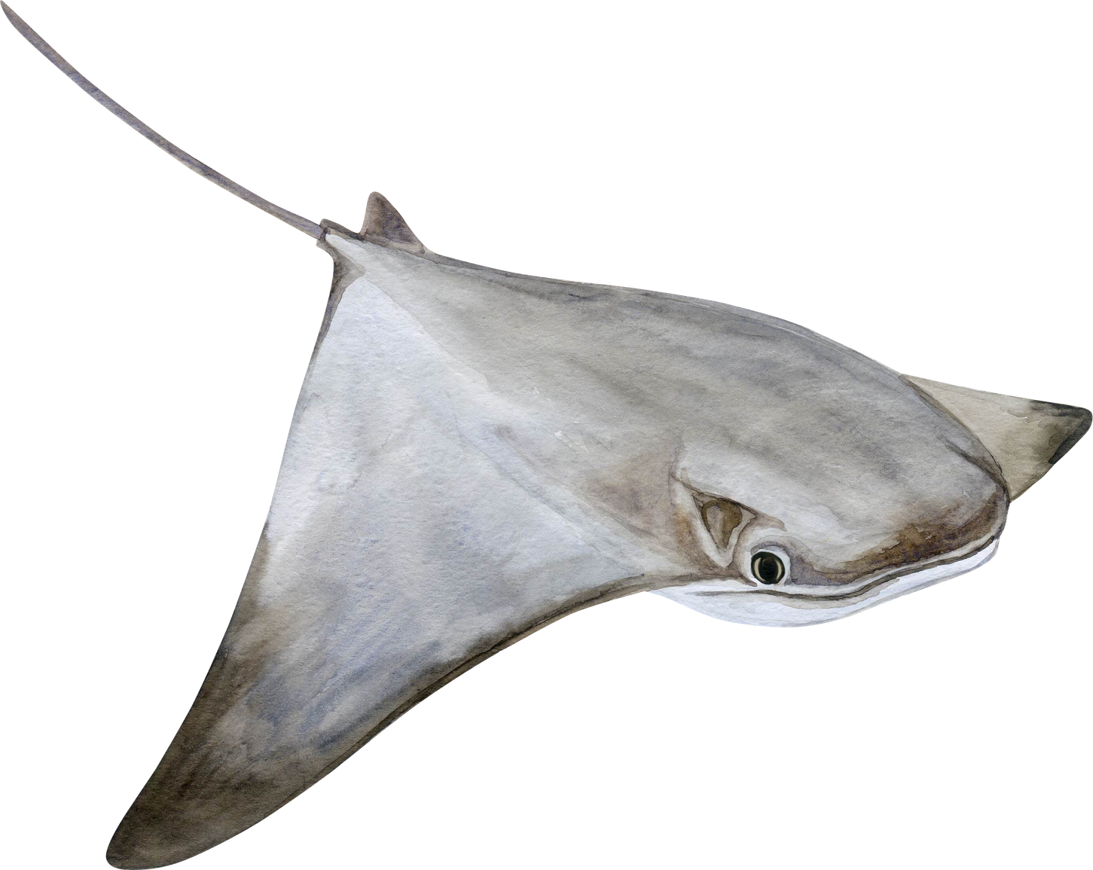
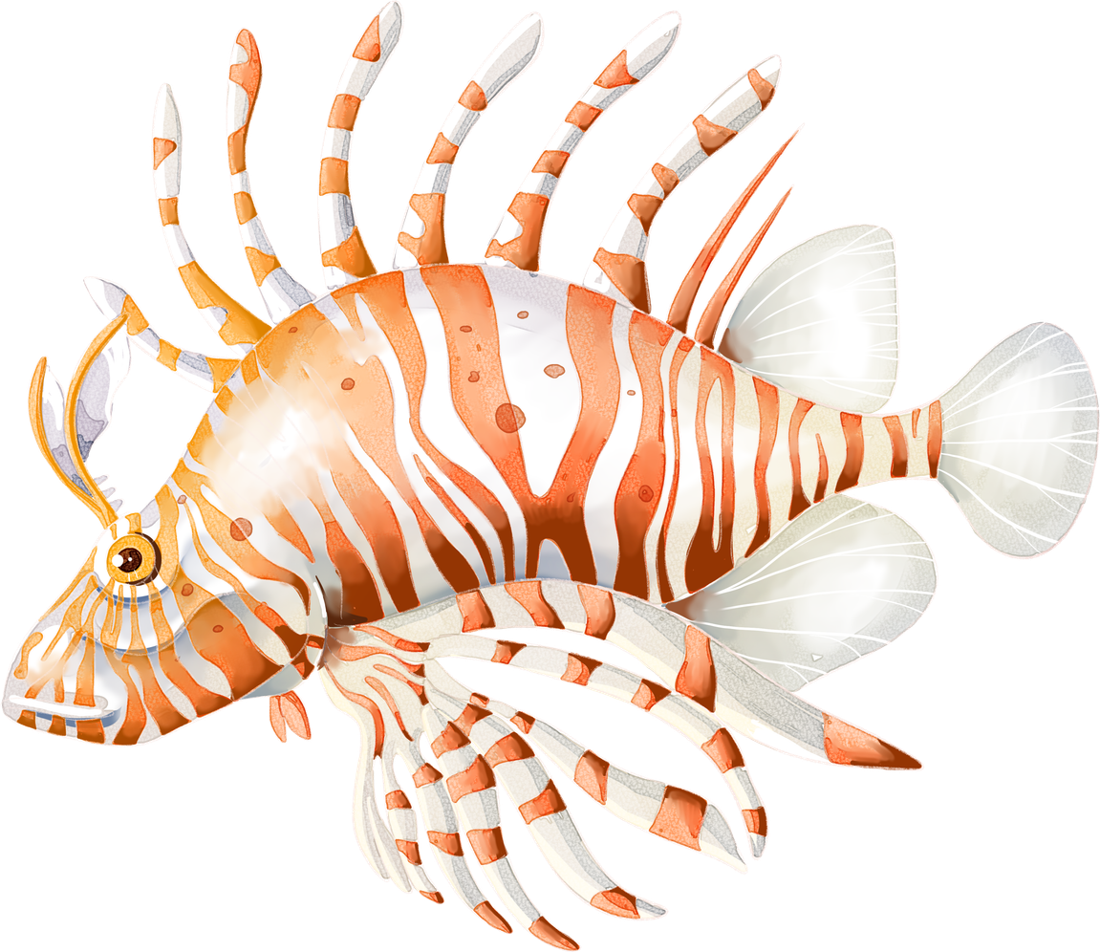
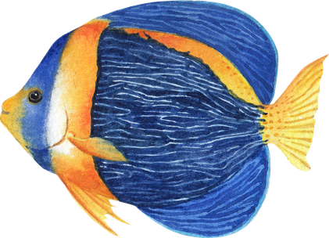
This Year’s Theme: Under the Sea
  Draw your favourite sea creature
  Use real sea life for inspiration
(fish, turtles, octopus, jellyfish, seahorses, whales)
On the back of your drawing, write:
  Why you chose this creature
  What it means to you

Slide 4
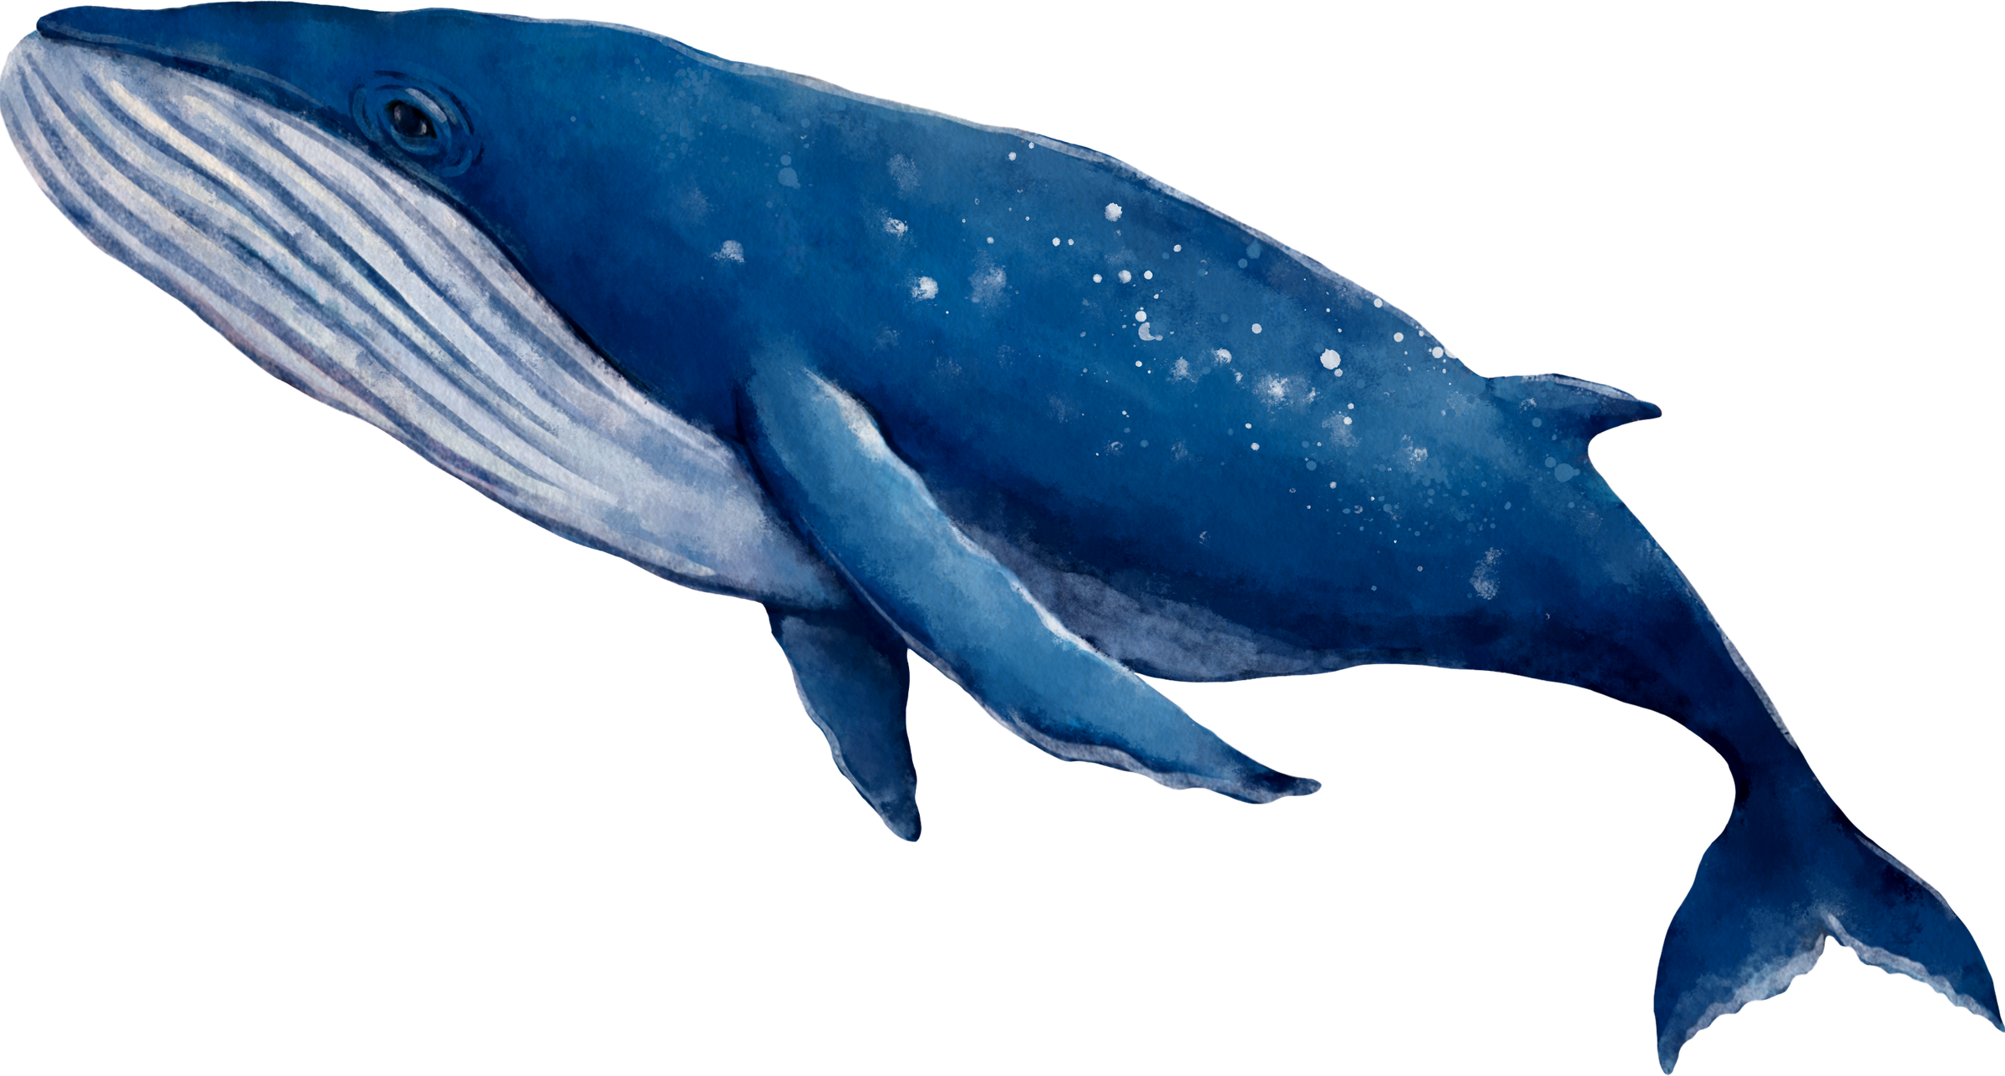
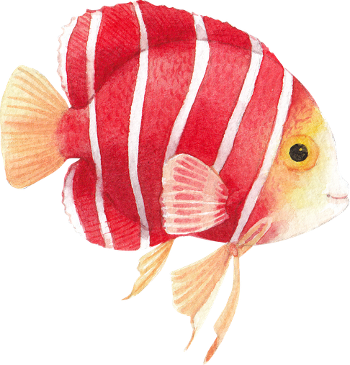
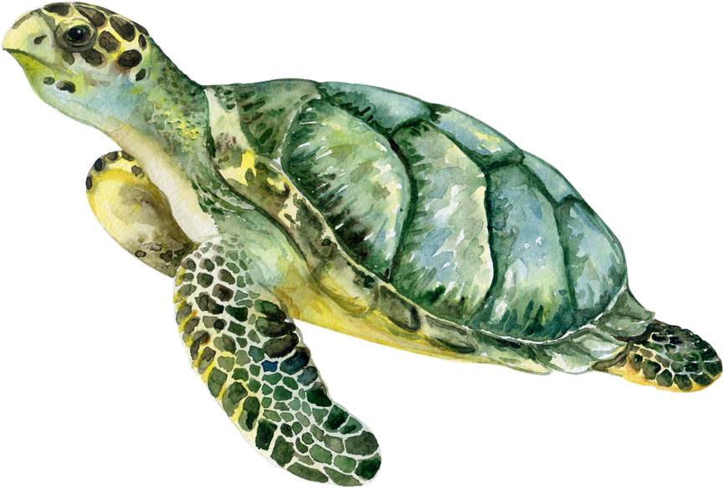
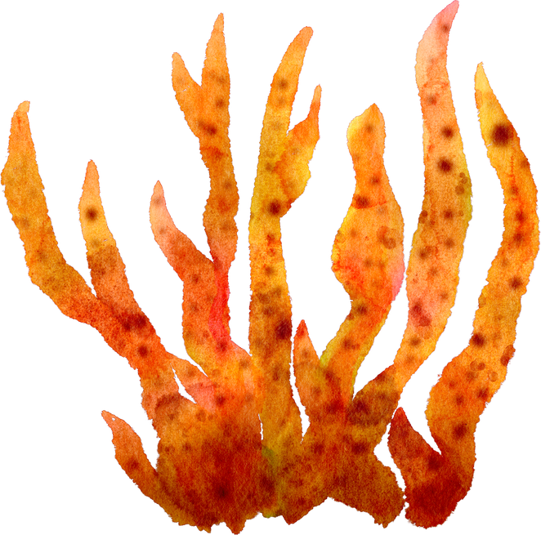
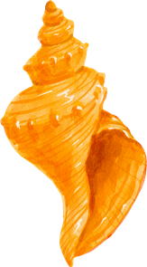
Design Tips
  Use bold, simple shapes
  Bright colours work well
  Add patterns or textures
  Imagine how it might look as a glass sculpture

Slide 5
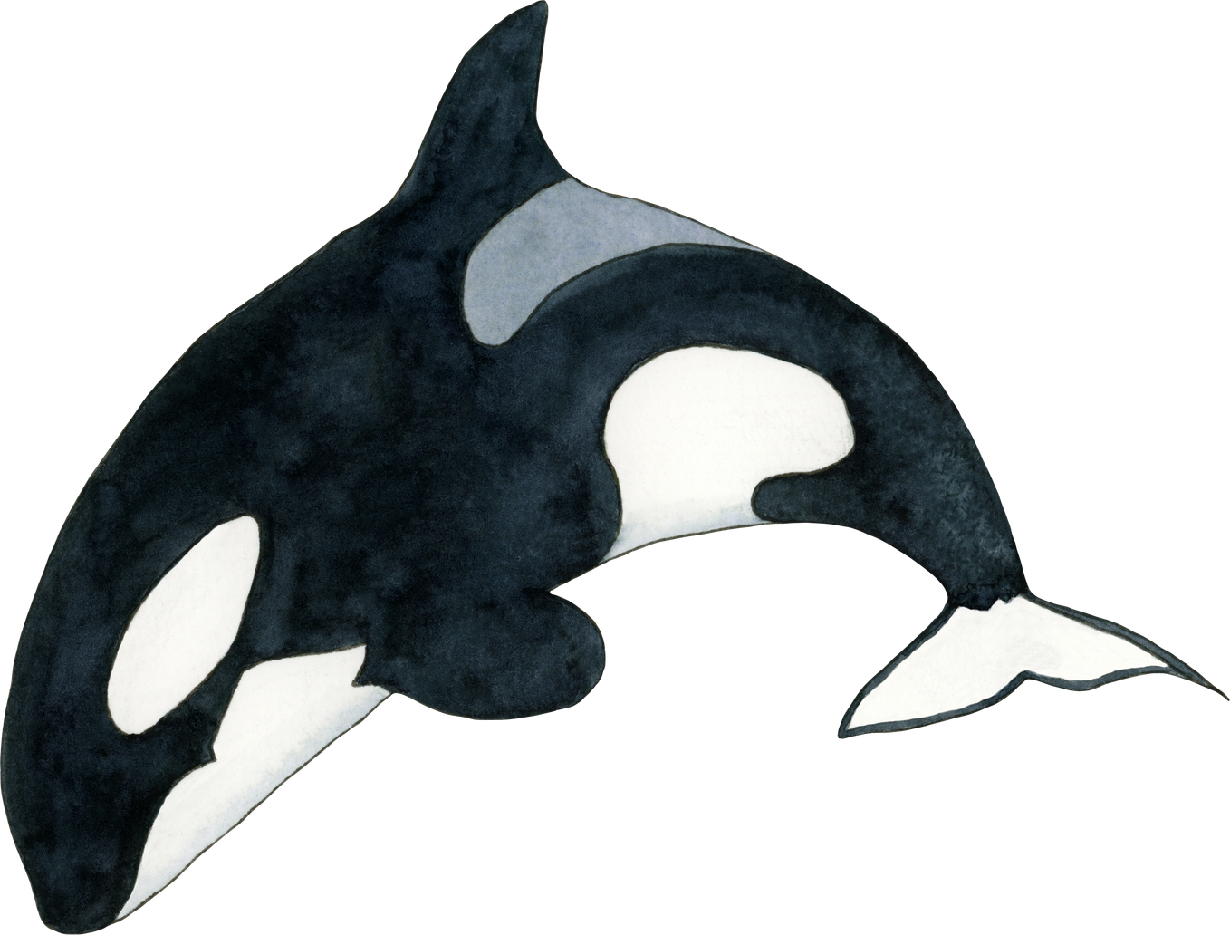
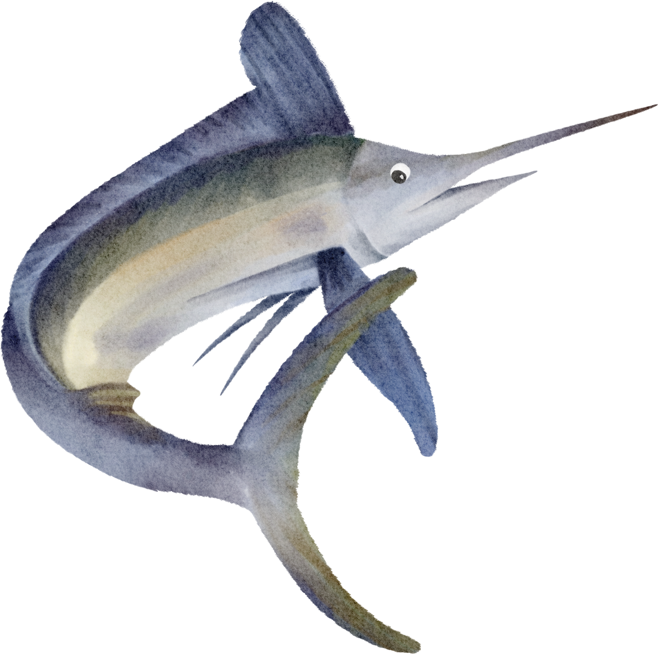
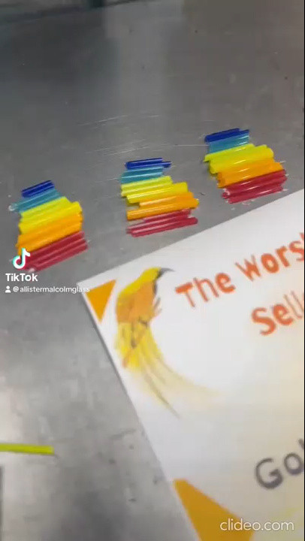
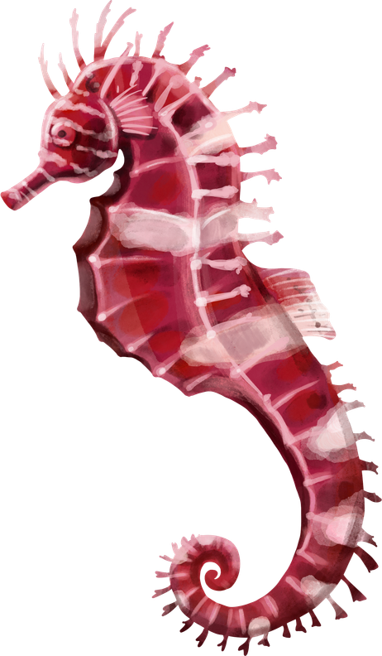
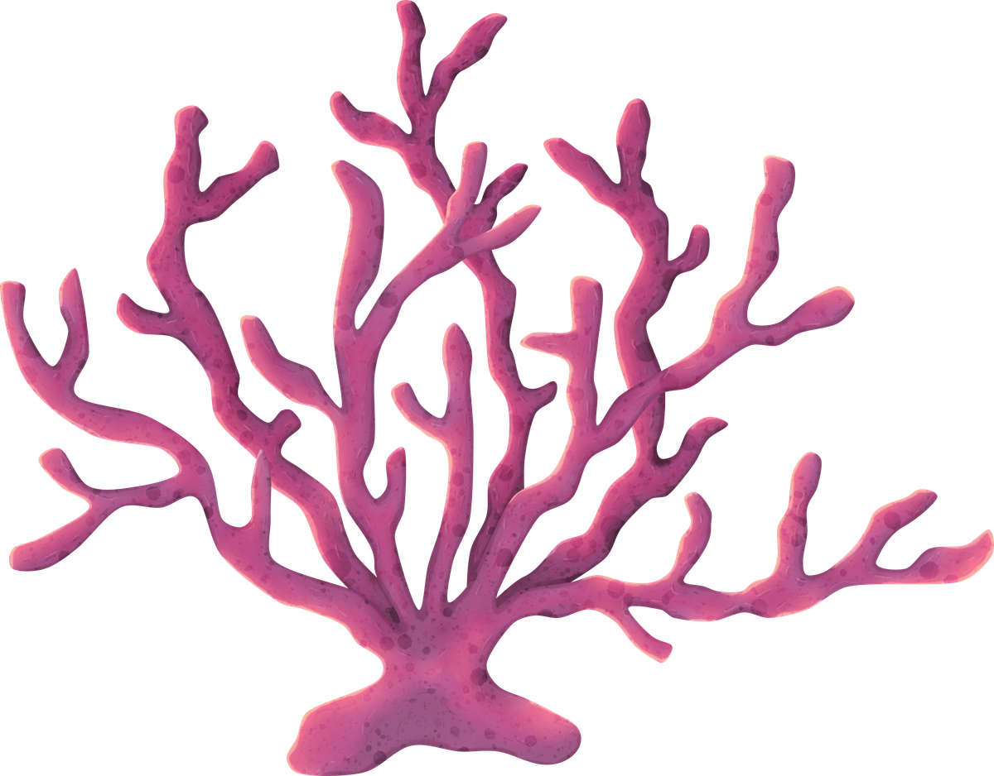
How to Enter
  Draw and colour your sea creature
  Write why you chose it
  Add your first name, class and school
  Give it to your teacher
See more videos
@allistermalcolm
on instagram and tiktok
Winners can visit the glass studio and see their work made in glass!

Slide 6
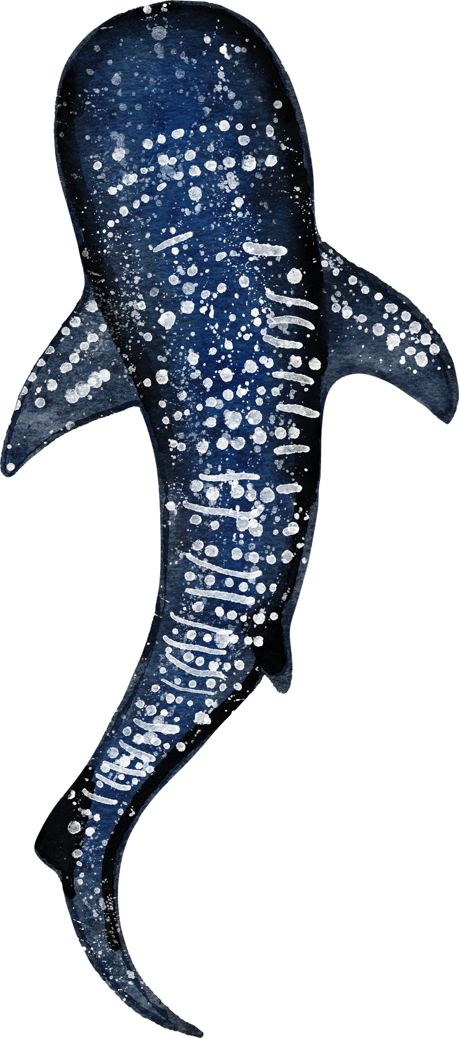
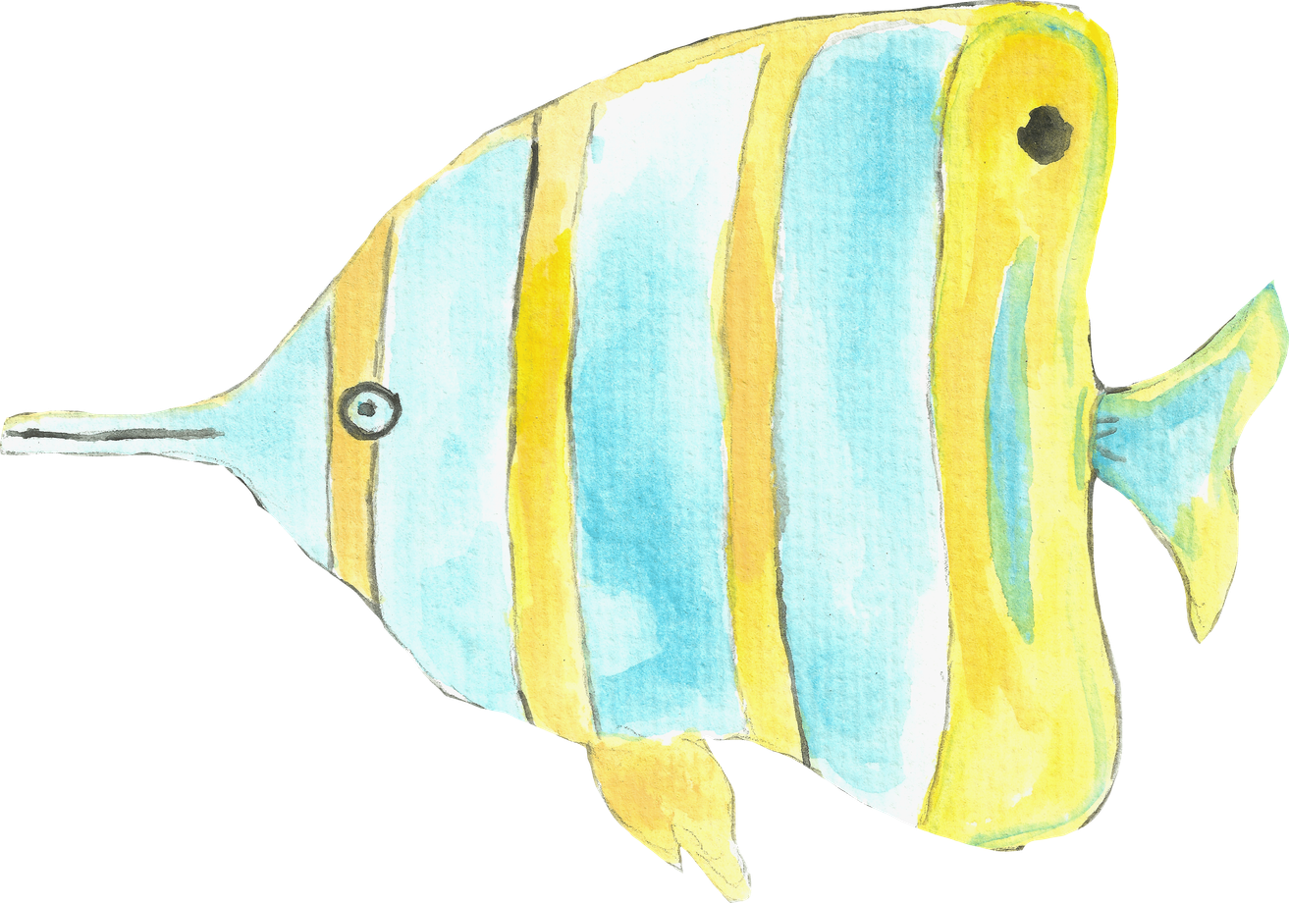
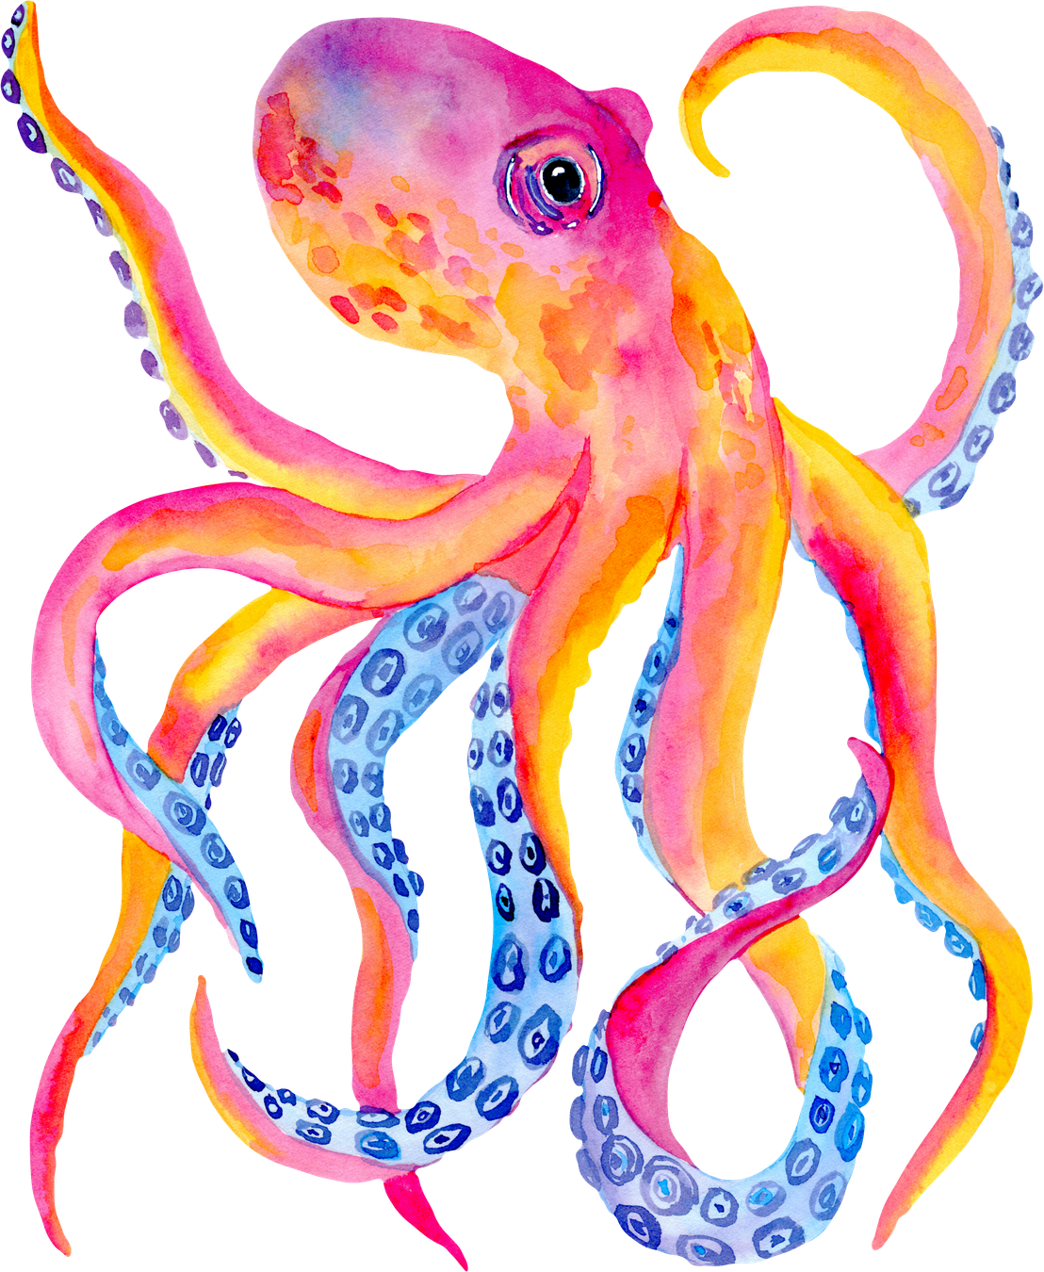
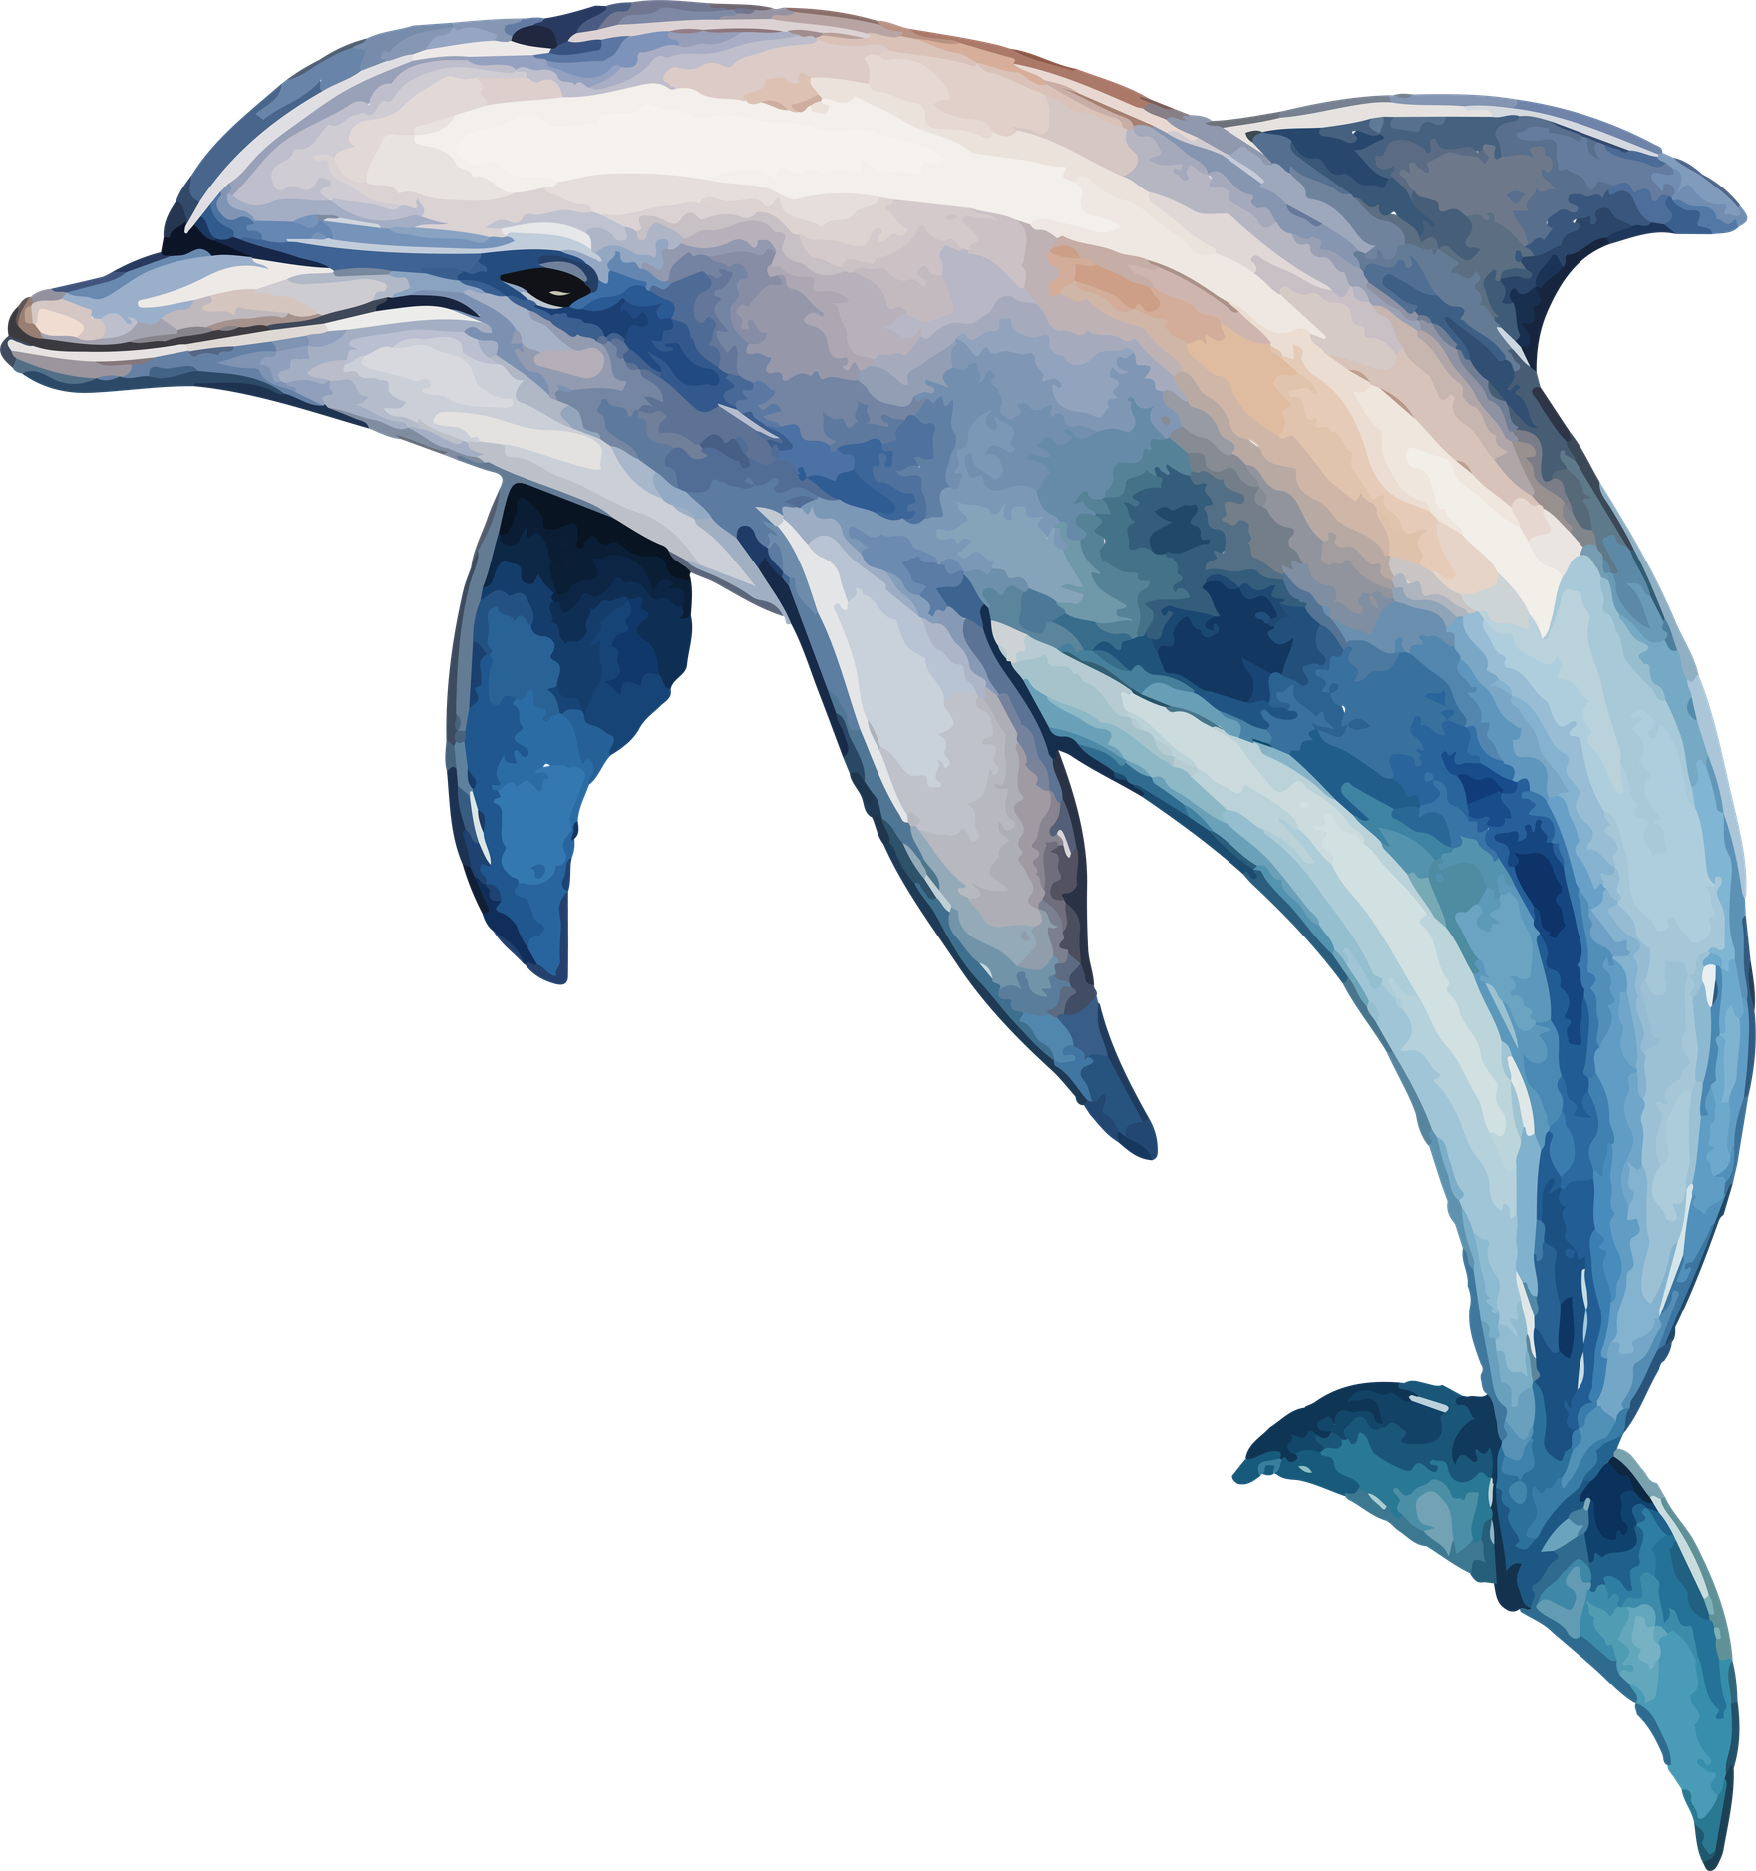
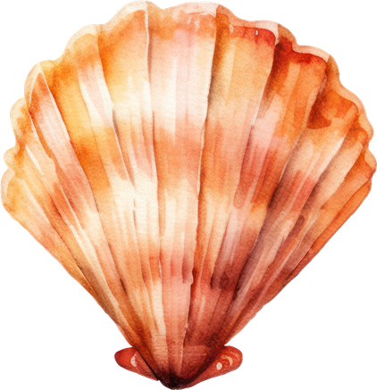
Good Luck!
We can’t wait to see your creations!

